Slide 1
Make thy kitchen pretty -
www.bukcal.com
#45, Bookhang-ro 207beon-gil,
Seo-gu, Incheon, Korea
TEL. +82-32-527-8380
FA X. +82-32-529-8081
Mail. eseragh@gmail.com
Blog. http://blog.naver.com/hankookseragh
Web. www.bukcal.com

Slide 2
PPL
BK-1101S
BUKCAL Classic
size: 165 x 165 x 298mm
Material: stainless, AvirulenceABS, AvirulencePC
Place of Origin: Korea
Packing: Color Box
Qty/Box: 6 EA
CBM: 0.076 ㎥
Single
knife
Kitchen knife
Fruit Knife
Tongs
Peeler
Handle
Use Guide
Set up products that you
want to sterilize.
Boil water in a pan and
put the product in the pan
for 1 to 2 minutes
for sterilization.
When sterilization is done, use a handle to take the products out from the hot water.
Use natural dry in a
place where
ventilation
is good.

Slide 3
* BUKCAL Classic Component
kitchen knife
fruit knife
scissors
tongs
peeler
BK-1101S-1
BK-1101S-2
BK-1101S-3
BK-1101S-4
BK-1101S-5
- Total length : 260 mm
- Blade length : 170 mm
- Handle length : 90 mm
Blade thickness : 2 mm
- weight : 90 g
- Total length : 210 mm
- Blade length : 120 mm
- Handle length : 90 mm
Blade thickness : 1.5 mm
- weight : 60 g
- Total length : 230 mm
- Blade length : 120 mm
Handle length : 110 mm
weight : 100 g
- Total length : 200 mm
- Handle length : 90 mm
weight : 70 g
- Total length : 180 mm
- Blade length : 50 mm
Handle length : 90 mm
weight : 10 g

Slide 4
BUKCAL CANDLE
BUKCAL CANDLE
FULL set!
PPL (Korean drama)
Set
BUKCAL CANDLE
Family set No.2
Single
BCF-01
BUKCAL CANDLE
Family set NO.1 (Full)
size: 365 x 342 x 73 mm
Material: stainless, ABS, PC
Place of Origin: Korea
Packing: Color Box
Qty/Box: 5 EA
CBM: 0.049 ㎥
cube10ea, knife, Fruit Knife3P, Kitchen knife’6, Kitchen knife’8, Tongs,
Fork4P, peleer(s), peleer(sw)

Slide 5
BCF-02
BUKCAL CANDLE
Family set No.2
BCS-01
BUKCAL CANDLE
Kitchen knife set
BCS-02
BUKCAL CANDLE
Fruit Knife set
Kitchen knife8, Kitchen knife6,
Fruit Knife3P,Fork4P,cube 8EA
size: 219 x 342 x 73 mm
Material: Stainless(ceramic coating),
ABS, PC
Place of Origin: Korea
Packing: PET
Qty/Box: 5 EA
CBM: 0.045 ㎥
size: 73 x 342 x 73 mm
Material: Stainless(ceramic coating),
ABS, PC
Place of Origin: Korea
Packing: PET
Qty/Box: 28 EA
CBM: 0.072 ㎥
size: 73 x 226 x 73 mm
Material: Stainless(ceramic coating),
ABS, PC
Place of Origin: Korea
Packing: PET
Qty/Box: 50 EA
CBM: 0.113 ㎥
BCS-03
BUKCAL CANDLE
Combination set
(Scissors & Tongs)
BCS-04
BUKCAL CANDLE
Peeler set
BCS-05
BUKCAL CANDLE
Fork set
size: 73 x 225 x 73 mm
Material: Stainless, ABS, PC
Place of Origin: Korea
Packing: PET
Qty/Box: 50 EA
CBM: 0.113 ㎥
size: 73 x 173 x 73 mm
Material: Stainless, ABS, PC
Place of Origin: Korea
Packing: PET
Qty/Box: 50 EA
CBM: 0.113 ㎥
size: 73 x 135 x 73 mm
Material: Stainless, ABS, PC
Place of Origin: Korea
Packing: PET
Qty/Box: 50 EA
CBM: 0.089 ㎥

Slide 6
BCI-01
BUKCAL CANDLE
Ceramic coating
Kitchen knife 8inch
BCI-02
BUKCAL CANDLE
Ceramic coating
Kitchen knife 6inch (wave)
BCI-03
BUKCAL CANDLE
Ceramic coating Fruit Knife 3P
size: 81 x 220 x 12 mm
Material: Stainless
(ceramic coating), ABS
Place of Origin: Korea
Packing: Single Blister
Qty/Box: 120 EA
CBM: 0.049 ㎥
size: 48 x 340 x 17 mm
Material: Stainless(ceramic coating)
ABS
Place of Origin: Korea
Packing: double Blister
Qty/Box: 90 EA
CBM: 0.100 ㎥
size: 33 x 290 x 17 mm
Material: Stainless(ceramic coating)
ABS
Place of Origin: Korea
Packing: double Blister
Qty/Box: 90 EA
CBM: 0.100 ㎥
[single size]
curved Fruit Knife: 170 x 20 x 10 mm
Standard knife : 200 x 20 x 10 mm
Bread knife : 220 x 20 x 10 mm
BCI-04
BUKCAL CANDLE
Scissors
BCI-05
BUKCAL CANDLE
Tongs
BCI-06
BUKCAL CANDLE
peeler (S)
BCI-07
BUKCAL CANDLE Fork 5P
size: 72 x 250 x 19 mm
Material: Stainless, ABS
Place of Origin: Korea
Packing: Single Blister
Qty/Box: 120 EA
CBM: 0.013 ㎥
size: 27 x 230 x 26 mm
Material: Stainless, ABS
Place of Origin: Korea
Packing: Single Blister
Qty/Box: 120 EA
CBM: 0.013 ㎥
size: 24 x 210 x 15 mm
Material: Stainless, ABS
Place of Origin: Korea
Packing: Single Blister
Qty/Box: 100 EA
CBM: 0.113 ㎥
size: 11 x 125 x 5 mm
Material: Stainless, ABS
Place of Origin: Korea
Packing: Single Blister
Qty/Box: 120 EA
CBM: 0.028 ㎥

Slide 7
v
BCI-01W
BUKCAL CANDLE WOOD
titanium coating
Kitchen knife 8inch
BCI-02W
BUKCAL CANDLE WOOD
titanium coating
Kitchen knife 6inch
size: 48 x 340 x 17 mm
Material: Stainless(titanium coating)
wood + TPR coating, ABS
Place of Origin: Korea
Packing: double Blister
Qty/Box: 90 EA
CBM: 0.100 ㎥
size: 33 x 290 x 17 mm
Material: Stainless(titanium coating)
wood + TPR coating, ABS
Place of Origin: Korea
Packing: double Blister
Qty/Box: 90 EA
CBM: 0.100 ㎥
BCI-03W
BUKCAL CANDLE WOOD
titanium coating Fruit Knife 3P
[single size]
curved Fruit Knife: 170 x 20 x 10 mm
Standard knife : 200 x 20 x 10 mm
Bread knife : 220 x 20 x 10 mm
BCI-04T
BUKCAL CANDLE BLACK
Titanium coating Scissors
BCI-05T
BUKCAL CANDLE BLACK
Titanium coating Tongs
size: 72 x 250 x 19 mm
Material: Stainless(titanium coating),
ABS
Place of Origin: Korea
Packing: Single Blister
Qty/Box: 120 EA
CBM: 0.013 ㎥
size: 27 x 230 x 26 mm
Material: Stainless, ABS
Place of Origin: Korea
Packing: Single Blister
Qty/Box: 120 EA
CBM: 0.013 ㎥
size: 81 x 220 x 12 mm
Material: Stainless(titanium coating), wood + TPR coating,
ABS
Place of Origin: Korea
Packing: Single Blister
Qty/Box: 120 EA
CBM: 0.049 ㎥

Slide 8
BCC-01
BCC-02
BUKCAL CUBE
BUKCAL CUBE support
size: 73 x 74 x 73 mm
Material: plastic
Place of Origin: Korea
Packing: PET
Qty/Box: 30 EA
CBM: 0.017㎥
size: 69 x 69 x 8 mm
Material: silicon
Place of Origin: Korea
Packing: Tag
Qty/Box: 50 EA
CBM: 0.028 ㎥
Use Guide
Tip. Stop up in the flowerpot's hole
with BUKCAL CUBE support!

Slide 9
Premium
kitchen knife(L)
Premium
kitchen knife(S)
Pattern kitchen knife
K-01L
K-01S
KG-110P
K-02
size: 1.5*335mm
Material: 420j2 Stainless),
ABS
Place of Origin: Korea
Packing: double Blister
Qty/Box: 70 EA
CBM: 0.072 ㎥
size: 1.5*295mm
Material: 420j2 Stainless),
ABS
Place of Origin: Korea
Packing: double Blister
Qty/Box: 70 EA
CBM: 0.072 ㎥
size: 1.5*295mm
Material: 420j2 Stainless),
ABS
Place of Origin: Korea
Packing: double Blister
Qty/Box: enquiry
CBM: enquiry
K-51
Premium
Fruit Knife
K-52
Premium Fruit
Knife with Cover
K-61O K-61B
Fruit Knife with Cover
size: 1.5*220mm
Material: 420j2 Stainless),
ABS
Place of Origin: Korea
Packing: Single Blister
Qty/Box: 200 EA
CBM: 0.045 ㎥
size: 1.2*230mm
Material: 420j2 Stainless),
ABS
Place of Origin: Korea
Packing: Single Blister
Qty/Box: 150 EA
CBM: 0.072 ㎥
size: 1.0*205mm
Material: 420j2 Stainless),
ABS
Place of Origin: Korea
Packing: (O) OPP
(B) Single Blister
Qty/Box: (O) 300 EA
(B) 200 EA
CBM: (O/B) 0.045 ㎥

Slide 10
S-01
Kitchen Scissors No.1
S-04
Kitchen Scissors No.4
S-05
Kitchen Scissors No.5
S-11
Kitchen Ambidextrous
Scissors (A)
size: 2.5*260mm
Material: Stainless, ABS
Place of Origin: Korea
Packing: Single Blister
Qty/Box: 120 EA
CBM: 0.072 ㎥
size: 1.8*215mm
Material: Stainless, ABS
Place of Origin: Korea
Packing: Single Blister Qty/Box: 200 EA
CBM: 0.072 ㎥
size: 2.0*225mm
Material: Stainless, ABS
Place of Origin: Korea
Packing: Single Blister
Qty/Box: 200 EA
CBM: 0.072 ㎥
size: 2.5*260mm
Material: Stainless, ABS
Place of Origin: Korea
Packing: Pad+OPP
Qty/Box: 200 EA
CBM: 0.072 ㎥
Yongmi Scissors
(Standard)
1000 safety scissors
S-12
Banana Scissors
S-21
S-51
size: 2.4*240mm
Material: Stainless, ABS
Place of Origin: Korea
Packing: Single Blister
Qty/Box: 130 EA
CBM: 0.072 ㎥
size: 3.0*270mm
Material: 420j2 stainless
chromium plating
Place of Origin: Korea
Packing: color box
Qty/Box: 50 EA
CBM: 0.045 ㎥
size: 1.0*140mm
Material: Stainless, ABS
Place of Origin: Korea
Packing: Pad+OPP
Qty/Box: 200 EA
CBM: 0.028 ㎥

Slide 11
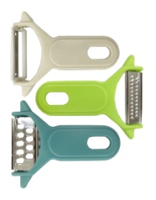
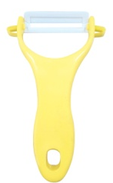
P-51O
Multi Slicer
P-51B
Multi Slicer
P-52
Talent Slicer
size: 320 x 110 x 12 mm
Material: stainless, ABS
Place of Origin: Korea
Packing: OPP / Single Blister
Qty/Box: (O) 150 / (B) 100
CBM: (O/B) 0.089 ㎥
size: 320 x 110 x 12 mm
Material: stainless, ABS
Place of Origin: Korea
Packing: OPP / Single Blister
Qty/Box: (O) 150 / (B) 100
CBM: (O/B) 0.089 ㎥
size: 320 x 110 x 12 mm
Material: stainless, ABS, SAN
Place of Origin: Korea
Packing: color box
Qty/Box: 100 EA
CBM: 0.113 ㎥
P-01
Three Piece Peelers
P-11
Peeler (L)
P-12
Ensemble Peeler
size: 70*150*12 mm
Material: stainless, PP
Place of Origin: Korea
Packing: Single Blister
Qty/Box: 300 EA
CBM: 0.113 ㎥
size: 80 x 120 x 20 mm
Material: stainless, PP
Place of Origin: Korea
Packing: Single Blister
Qty/Box: 280 EA
CBM: 0.113 ㎥
size: 180*170*10mm
Material: stainless, PP
Place of Origin: Korea
Packing: OPP
Qty/Box: 300 EA
CBM: 0.113 ㎥
P-13
Three Functions Peeler
P-14
Shredding Peeler
P-15
Well-being Peeler
P-16
Ceramics Peeler
size: 60*170*19mm
Material: stainless, PP
Place of Origin: Korea
Packing: Single Blister
Qty/Box: 250 EA
CBM: 0.113 ㎥
size: 60*170*19mm
Material: stainless, PP
Place of Origin: Korea
Packing: Single Blister
Qty/Box: 250 EA
CBM: 0.113 ㎥
size: 84*198*24mm
Material: stainless, PP
Place of Origin: Korea
Packing: Single Blister
Qty/Box: 100 EA
CBM: 0.072 ㎥
size: mm
Material: PP
Place of Origin: Korea
Packing:
Qty/Box: EA
CBM: ㎥

Slide 12
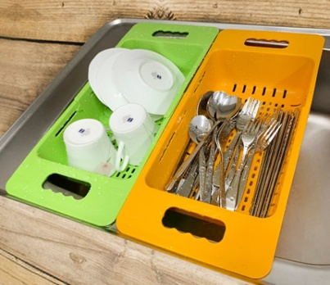
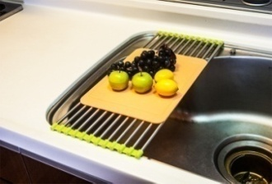
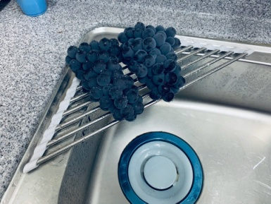
P-53
Cabbage Slicer
P-54
Shredding Slicer
E-20
Sliding basket
Size: 380x 185x 78 Material: PP Origin: Korea Packing: Bulk Qty/Box : 60ea CBM: 0.0716
size: 130 x 355 x 47 mm
Material: Stainless, ABS, SAN
Place of Origin: Korea
Packing: Color Box
Qty/Box: 50 EA
CBM: 0.139 ㎥
size: 130 x 355 x 47 mm
Material: Stainless, ABS, SAN
Place of Origin: Korea
Packing: Color Box
Qty/Box: 30 EA
CBM: 0.089 ㎥
E1-01
Sink Roll 12P
E1-02
Sink Roll 24P
E-21
Sink Roll-corner type
size: 210*510mm
Material: stainless, elastomer
Place of Origin: Korea
Packing: Pad + OPP
Qty/Box: 60 EA
CBM: 0.089 ㎥
size: 420*510mm
Material: stainless, elastomer
Place of Origin: Korea
Packing: Pad + OPP
Qty/Box: 30 EA
CBM: 0.089 ㎥
size: 460*150mm Material: stainless, elastomer Place of Origin : Korea Packing: Pad + OPP Qty/Box : 70ea CBM: 0.0716 ㎥

Slide 13
T-270S
Serration Tongs(L)
T-250S
Serration Tongs(M)
T-210S
Serration Tongs(S)
T-270B
Bread Tongs(L)
T-250B
Bread Tongs(M-17)
size: 20*270mm
Material: 430 Stainless
Place of Origin: Korea
Packing: OPP
Qty/Box: 300 EA
CBM: 0.072 ㎥
size: 20*250mm
Material: 430 Stainless
Place of Origin: Korea
Packing: OPP
Qty/Box: 300 EA
CBM: 0.072 ㎥
size: 17*210mm
Material: 430 Stainless
Place of Origin: Korea
Packing: OPP
Qty/Box: 300 EA
CBM: 0.072 ㎥
size: 20*270mm
Material: 430 Stainless
Place of Origin: Korea
Packing: OPP
Qty/Box: 300 EA
CBM: 0.072 ㎥
size: 17*220mm
Material: 430 Stainless
Place of Origin: Korea
Packing: OPP
Qty/Box: 300 EA
CBM: 0.064 ㎥
T-225M
Multi-purpose
Tongs(L)
T-200M
Multi-purpose
Tongs(M)
T-160P
Ice Tongs(plastic)
T-160I
Ice Tongs
size: 17*225mm
Material: 430 Stainless
ABS
Place of Origin: Korea
Packing: opp
Qty/Box: 300 EA
CBM: 0.064 ㎥
size: 17*200mm
Material: 430 Stainless
ABS
Place of Origin: Korea
Packing: opp
Qty/Box: 300 EA
CBM: 0.064 ㎥
size: 17*160mm
Material: 430 Stainless
ABS
Place of Origin: Korea
Packing: opp
Qty/Box: 300 EA
CBM: 0.045 ㎥
size: 17*160mm
Material: 430 Stainless
Place of Origin: Korea
Packing: opp
Qty/Box: 300 EA
CBM: 0.045 ㎥
T-01L
Auto
Serration Tongs
T-02L
Auto
Sunflower Tongs
T-03L
Auto
Square Tongs
size: 40*265mm
Material: 430 Stainless
ABS
Place of Origin: Korea
Packing: Tag
Qty/Box: 200 EA
CBM: 0.045 ㎥
size: 40*265mm
Material: 430 Stainless
ABS
Place of Origin: Korea
Packing: Tag
Qty/Box: 200 EA
CBM: 0.045 ㎥
size: 40*265mm
Material: 430 Stainless
ABS
Place of Origin: Korea
Packing: Tag
Qty/Box: 200 EA
CBM: 0.045 ㎥

Slide 14
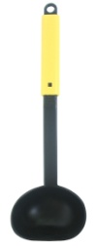
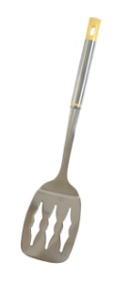
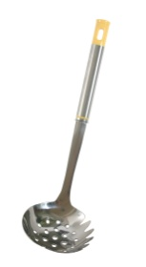
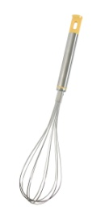
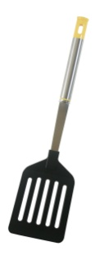
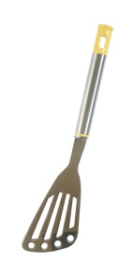
U-01
Self Cook Turner
U-02
Self Cook Ladle
U-03
Self Cook diagonal line Turner
U-04
Self Cook grater
U-05
Self Cook Ballon Whisk
UK-181
Crown Turner
size: 55*230mm
Material: nylon66, silicon
Place of Origin: Korea
Packing: Tag
Qty/Box: 180 EA
CBM: 0.045 ㎥
size: 50*235mm
Material: nylon66, silicon
Place of Origin: Korea
Packing: Tag
Qty/Box: 150 EA
CBM: 0.045 ㎥
size: 60*250mm
Material: nylon66, silicon
Place of Origin: Korea
Packing: Tag
Qty/Box: 150 EA
CBM: 0.072 ㎥
size: 75*245mm
Material: nylon66, silicon
Place of Origin: Korea
Packing: Tag
Qty/Box: 150 EA
CBM: 0.045 ㎥
size: 60*250mm
Material: nylon66, silicon
Place of Origin: Korea
Packing: Tag
Qty/Box: 180 EA
CBM: 0.045 ㎥
size: 70*290mm
Material: Stainless, ABS
Place of Origin: Korea
Packing: Tag
Qty/Box: 180 EA
CBM: 0.113 ㎥
Crown Ladle(M)
UK-183
Crown Ladle(L)
UK-184
Crown
Straining Ladle
UK-185
Crown Solid Spoon
UK-186
Crown Ballon Whisk
UK-187
Crown Long fork
UK-182
UK-187
size: 80*280mm
Material: Stainless, ABS
Place of Origin: Korea
Packing: Tag
Qty/Box: 150 EA
CBM: 0.045 ㎥
size: 92*300mm
Material: Stainless, ABS
Place of Origin: Korea
Packing: Tag
Qty/Box: 150 EA
CBM: 0.072 ㎥
size: 80*280mm
Material: Stainless, ABS
Place of Origin: Korea
Packing: Tag
Qty/Box: 150 EA
CBM: 0.045 ㎥
size: 60*290mm
Material: Stainless, ABS
Place of Origin: Korea
Packing: Tag
Qty/Box: 180 EA
CBM: 0.045 ㎥
size: 60*280mm
Material: Stainless, ABS
Place of Origin: Korea
Packing: Tag
Qty/Box: 100 EA
CBM: 0.072 ㎥
size: 30*295mm
Material: Stainless, ABS
Place of Origin: Korea
Packing: Tag
Qty/Box: 200 EA
CBM: 0.045 ㎥
UK-188
Crown
nylon Turner
UKM-181
Crown
Mini Turner
UKM-182
Crown Ladle(S)
UKM-186
Crown Mini
Ballon Whisk
UK-188
UKM-181
UKM-182
UKM-186
size: 80*330mm
Material: Stainless, ABS,
nylon66
Place of Origin: Korea
Packing: Tag
Qty/Box: 180 EA
CBM: 0.045 ㎥
size: 70*280mm
Material: Stainless, ABS
Place of Origin: Korea
Packing: Tag
Qty/Box: 200 EA
CBM: 0.045 ㎥
size: 80*280mm
Material: Stainless, ABS
Place of Origin: Korea
Packing: Tag
Qty/Box: 200 EA
CBM: 0.045 ㎥
size: 60*250mm
Material: Stainless, ABS
Place of Origin: Korea
Packing: Tag
Qty/Box: 150 EA
CBM: 0.045 ㎥

Slide 15
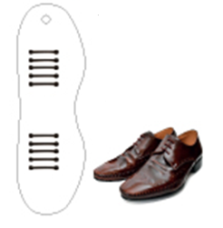
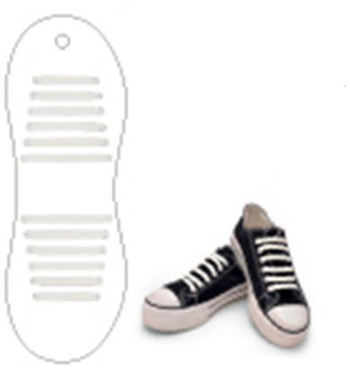
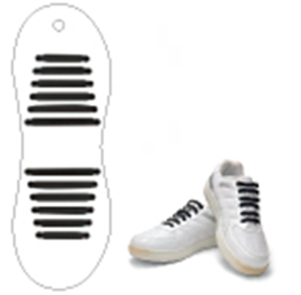
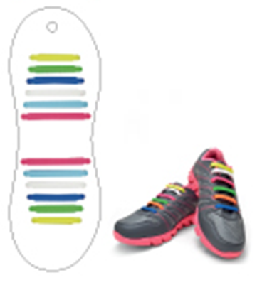
EL-01
silicon shoelace 10P
EL-02W
silicon shoelace for sneakers(white)
EL-02B
silicon shoelace for sneakers (Black)
EL-03
silicon shoelace for sneakers (Color)
size: 262*85*5mm
Material: silicon
Place of Origin: Korea
Packing: Pad + OPP
Qty/Box: 448 EA
CBM: 0.075 ㎥
size: 262*90*5mm
Material: silicon
Place of Origin: Korea
Packing: Pad + OPP
Qty/Box: 448 EA
CBM: 0.056 ㎥
size: 262*90*5mm
Material: silicon
Place of Origin: Korea
Packing: Pad + OPP
Qty/Box: 448 EA
CBM: 0.056 ㎥
size: 262*90*5mm
Material: silicon
Place of Origin: Korea
Packing: Pad + OPP
Qty/Box: 448 EA
CBM: 0.056 ㎥

Slide 16
(원창동 393-22)

