Slide 1
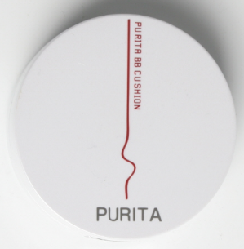
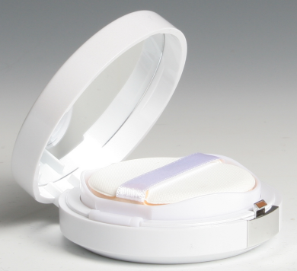
BB AIR CUSHION - GS219
Feature & Function│
1. All in one Multi Cushion
UV Protection (SPF50+/PA+++) + Makeup + Cooling + Brightening + Wrinkle Care + Moist Mist
2. Slim &Light Cover -Silly Skin Effect
3. Whitening
4. Anti-wrinkle
5. Only Healthy Ingredients Used
Volume
Include Refill 27g(12g+15g)
* Ingredients
Aqua, Collagen(5%), Ixeris Dentata, Oputia Ficus-Indica Extract, Alcohol,
Citrus Grandis (Grapefruit) Seed Extract, Pollen Extract, Chito Oligosaccharide,
Caprylyl Glycos, Glycerin, Caprylo-Hydroxamic Acid, PEG-60 Hydrogenated Castor Oil,
Disodium EDTA, Fragrance
How to use
By using air puff, apply appropriate amount to your skin.
For the parts which are needed cover, apply one more time lightly
Optional Information
- Origin : Made in Korea - Minimum Order : 3000
- Packaging : / 100 in box/ 6 boxes in carton
-Unit Price:＄6.10USD

