Slide 1
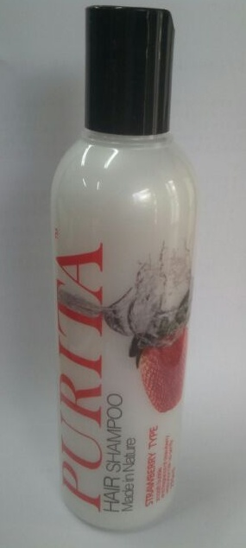
SHAMPOO STRAWBERRY
Feature & Function│
Make your hair become natural again
Anti-static
Shampoo for healthy hair within twinkle shine
12 kinds of natural extracts
Fresh fragrance-feel up
You can feel with light your hair
Volume
270ml/9.18FL..Oz.
* Ingredients
Purified water,Sodium Laureth sulfate, Cocamidopropyl Betain, Sodium Lauryl Sulfate, TEA-Lauryl
Sulfate, Lauramide DEA, Dimethicone/ Cocamidopropyl Betain,Perfume, Glycol Distearate,, Cocamide
DEA, Polyquaternium-7, Fragaria Chiloensis (Strawberry) Fruit Extract, Phenoxyethanol, Citric Acid,
Polyquaternium-10, Panthenol, Allantoin, Acorus Calamus Root Extract Polygonum Multiflorum Root
Extract Glycine Soja (Soybean) Seed Extract,Morus Alba Bark Extract, Astragalus Membranaceus Root
Extract, Laminaria Japonica Extract Angelica Gigas Root Extract ,Camellia Sinensis Leaf Extract,
Zingiber Officinale (Ginger) Root Extract, Sophora Angustifolia Root Extract Sodium Citrate, Disodium EDTA
How to Use
1.Wet hair with water
2.Take proper account of this product and evenly
smear on hair
3.Soft massage scalp with finger pulp
4.Rinse with water
Optional Information
- Origin : Made in Korea - Minimum Order : 400
- Packaging : / 10 in box/ 4boxes in carton
-Unit Price:＄2.30USD/Fob

