Slide 1
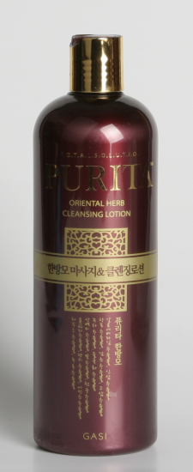
ORIENTAL HERB CLEANSING LOTION (SHAMPOO )
Feature & Function│
HERB SHAMPOO made out of NATURAK HERB INGRDINTS.
The innovative combination of 15 natural herbal ingredients including natural herbal preservatives
naturally present in herb help give freshness, natural herbal smell,exceptional clean and strength to
your hair. To keep your hair healthy
HERB SHAMPOO PROVIDES NATURAL HERB NUTRITION TO YOUR SCALP AND HAIR.
So it helps your hair and scalp become healthy and strong in natural way
Volume
500ml/16.9FL.Oz
* Ingredients
Purified water, Sodium Laureth sulfate, Cocamidopropyl Betain, Sodium Lauryl Sulfate, Lauramide DEA, Cnidium Officinale Root Extract, Perfume, Methylparaben, Cocamide DEA, Polyquaternium-7, Caramel, Phenoxyethanol, Citric Acid, Polyquaternium-10, Panthenol, Allantoin, Aloe Barbadensis Leaf Extract, Panax Ginseng Root Extract, Acorus Calamus Root Extract, Glycyrrhiza Glabra (Licorice) Root Extract, Sophora Angustifolia Root Extrac, Camellia Sinensis Leaf Extract, Tanacetum Vulgare Extract, Morus Alba Bark Extract, Artemisia Vulgaris Extract, RosmarinusOfficinalis (Rosemary) Extract, Angelica Gigas Root Extract, Houttuynia Cordata Extract, Polygonum Multiflorum Root Extract, Velvet Extract,
How to Use
1.Wet hair with water
2.Take proper account of this product and evenly
smear on hair
3.Soft massage scalp with finger pulp
4.Rinse with water
Optional Information
- Origin : Made in Korea - Minimum Order : 500
- Packaging : / 50 in box/
-Unit Price:＄4.40/USD/Fob

